Slide 1

Risk & Return Analysis of Indian IT Stocks
FY 2018 - 2026
GitHub Link
Reported By : Chinmayi Sutar
Email: Chinmayi2396@gmail.com

Slide 2

Content
Objective
Pattern Analysis
Normalized Price Performance
Rolling Volatility Plot
Correlation Heatmap
Drawdown Analysis
Trading Risk/ Idea
Key Takeaways
5. Disclaimer

Slide 3
1. Objective This report analyses Monthly Closing Prices of 4 Major Indian Information Technology (IT) equities from Financial Year 2018- 2026 to study investment return behaviour, market volatility and inter-stock relationship within the sector and propose a simple risk-based Investment Idea
List of IT Stocks
Infosys
HCL Tech
Tech Mahindra
Oracle Finance Services Software (OFSS)
Time Period: Apr 2018 – Mar 2026 (7 years)
Time Interval: Monthly
Data Source: Yahoo Finance
Data Analysis Tools & Frameworks: VS Code, Python (Pandas, Numpy, Matplotlib, Seaborn)

Slide 4
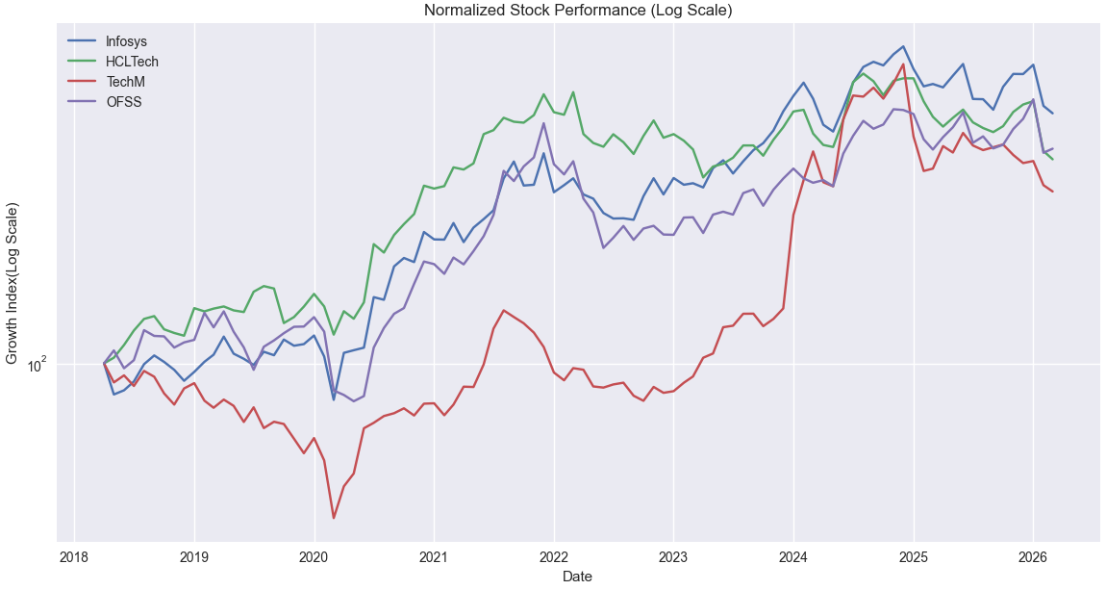
2. Pattern Analysis
a) Normalized Price Performance
OFSS (purple) is the clear long-term winner — it ends the period at the highest level. Despite starting at the bottom of the pack in 2018, it surged dramatically from post covid and 2023 onward.
HCL Tech (green) is the second-best performer — it shows steady, consistent growth throughout the period
Infosys (blue) tracks closely with HCL Tech for most of the period but diverges slightly lower toward 2025–2026
Tech Mahindra (red) is the weakest performer — it's the only stock that spends significant time below its starting value (2018–2020), and despite a strong 2023–2024 rally, it has pulled back sharply into 2026.

Slide 5
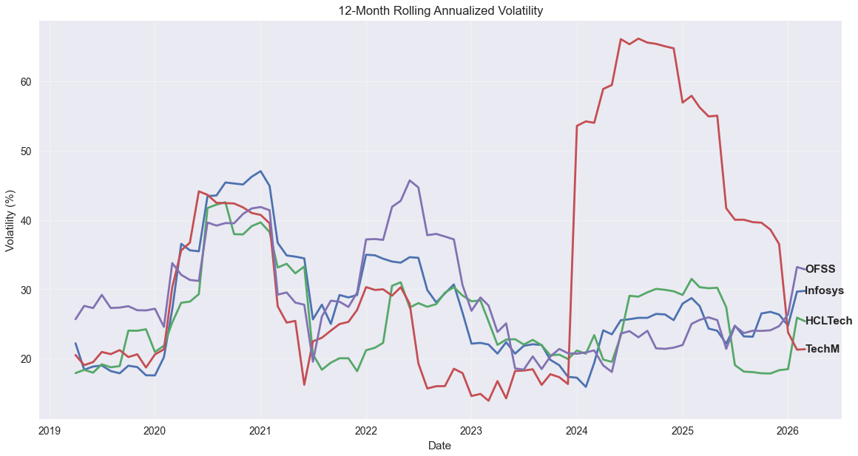
b) Rolling Volatility Plot
Annualized Volatility
Measures price fluctuations (Risk) Higher Volatility = Higher Uncertainty/risk
Rank | Stock | Volatility (%)
1 | Tech Mahindra | 36.52
2 | OFSS | 29.79
3 | Infosys | 28.55
4 | HCL Tech | 26.70
Insights
Tech Mahindra is the most volatile (36.52%), about 10% points more volatile than HCL Tech (26.70%).
OFSS and Infosys show similar mid-range risk profiles (28–30%).
All stocks spike during market stress, with Tech Mahindra swinging the most.

Slide 6
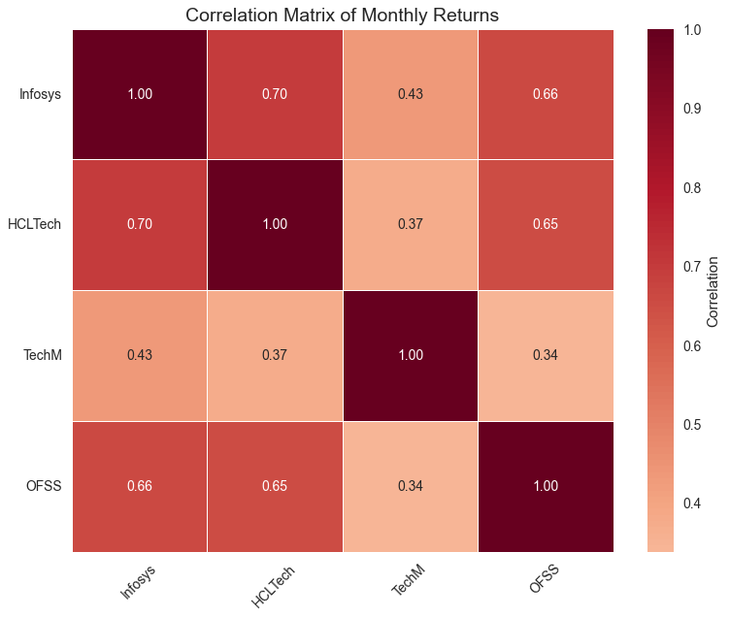
c) Correlation Heatmap
Correlation between monthly returns was analysed to assess diversification benefits within the IT sector
Insights
Infosys, HCL Tech & OFSS (0.65–0.70) — meaning they tend to rise and fall together, reducing the benefit of holding all 3.
Tech Mahindra is the outlier (0.34 -0.43) - moves more independently, which, combined with its higher volatility from slide 4, offering a high-risk / high-diversification trade-off.
Optimal two-stock pair: HCL Tech + Tech Mahindra — combines the lowest volatility with the lowest correlation for maximum risk reduction.
Correlation | Meaning
+1.0 | Move exactly together
0.7 – 0.9 | Strong positive relationship
0.4 – 0.6 | Moderate relationship
0.0 | No relationship

Slide 7
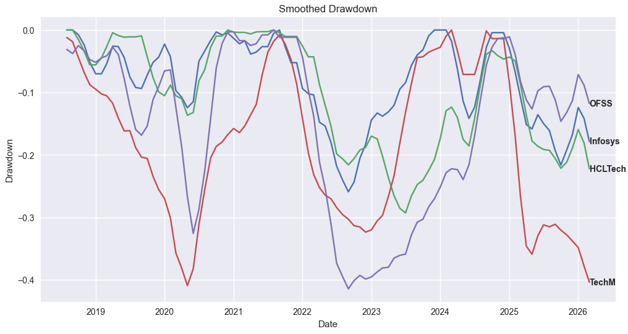
d) Drawdown Analysis
Drawdown measures how far a stock falls from its previous peak.
Insights
2020 COVID Crash
TechM and OFSS recorded deepest drawdown, falling close to 40% from all time high
Infosys and HCL Tech declined but recovered relatively faster
2. 2022 Inflation and Global Slowdown
OFSS showed steepest prolonged drawdowns
2025-2026 ongoing AI-Driven IT Rerating Phase
TechM currently exhibits sharpest drawdown among four, indicating higher market uncertainty
Infosys and HCL Tech demonstrated comparatively better resilience in all 3 market crashes

Slide 8
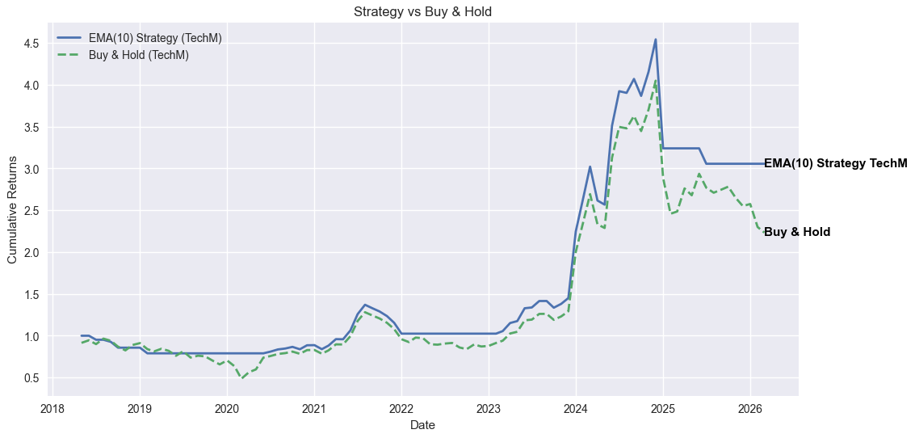
3. Trading Risk/ Idea
EMA 10 Strategy vs Buy & Hold — Tech Mahindra (FY 2018–2026)
The EMA 10 approach is a momentum-based timing strategy
buy when the monthly close is above the 10-month Exponential Moving Average,
sell (or halve allocation) when it drops below EMA 10
It's designed to sidestep Tech Mahindra's high volatility identified earlier (36.52%).
WEAKNESS
- Overfitting: strategy worked historically may fail future regimes
Analysis Ignores interest rates, USD/INR effects, Global tech sentiment
- Monthly data may miss intra-month reversals
- Transaction cost: frequently rebalancing may reduce profitability
The strategy line (solid) stays above Buy & Hold (dashed) for most of the period, particularly pulling ahead during recovery phases after 2023. This suggests the EMA signal effectively timed re-entry after drawdowns

Slide 9
3. Trading Risk/ Idea
Why the Risk/Idea is Useful?
Performance Matrix
CAGR of 15.15% vs 10.67% — the EMA strategy outperformed buy & hold by roughly 4.5 percentage points annually over 7 years.
Volatility dropped from 36.52% to 31.03% — a ~15% reduction in risk while delivering higher returns
Sharpe Ratio of 0.48 vs 0.29 — the strategy delivers 65% better risk-adjusted returns, meaning each unit of risk taken produces substantially more return.
Max Drawdown cut from 50% to 32% — the strategy avoided nearly 18 percentage points of peak-to-trough decline, likely by exiting before the worst of the 2020 COVID crash and the 2025 correction.
Parameter | EMA 10 Strategy (%) | Buy & Hold benchmark (%)
CAGR | 15.15 | 10.67
Annual Volatility | 31.03 | 36.52
Sharpe Ratio | 0.48 | 0.29
Max Drawdown | 32% | 50%

Slide 10
4. Key Takeaways
HCL Tech and Infosys offered the best risk-adjusted journey — strong returns with the smoothest, most consistent growth path and lowest volatility even in big market crashes
OFSS Breakout (2023-2024) – delivered the highest absolute returns of the group with a dramatic breakout (slide 4), while maintaining mid-range volatility — quietly outperforming the larger IT stocks. Its moderate correlation with all 4 stocks and manageable drawdown profile make it relatively stable for investors looking beyond the usual large-cap IT bets.
Tech Mahindra's high volatility is a double-edged sword — it had explosive rallies (2023–2024) but equally sharp declines , reinforcing why the EMA 10 strategy from slide 8 was proposed specifically for this stock.

